Slide 1
Automated Detection of Cyberbullying Occurrences in Social Media Posts Using Support Vector Machine (SVM) Algorithm
Samantha Mallari
Faith Ballesteros
Eva Samillano

Slide 2
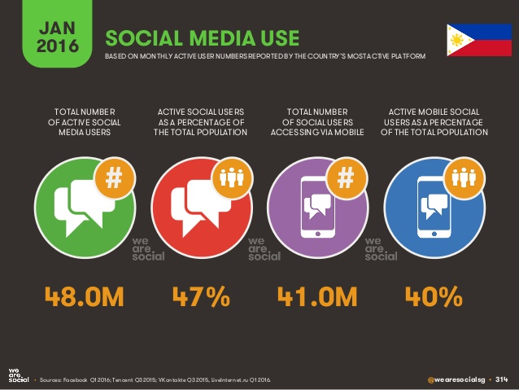
Social media use in the Philippines

Slide 3
Background of the Problem
Introduction to cyberbullying
Must be:
-involuntary
-harmful/offensive
-repetitive
-utilized technology as medium

Slide 4
Background of the Problem
Cyberbullying in the Philippines
Countermeasures:
- R.A. 10627 – Anti-bullying Act of 2013
- House Bill 5718 – Anti-cyberbullying Act of 2015

Slide 5
Statement of the Problem
How can the detection of cyberbullying occurrences in public social media posts be automated?

Slide 6
Main Objective
This research aims to develop a cyberbullying detection model based on the concept of text classification

Slide 7
Specific Objectives
To acquire data for the corpus
To perform the cleaning procedure for the dataset
To extract features from the corpus
To perform text annotations
To perform the Bag-of-Words (BoW) approach
To implement the text classification algorithm (SVM)

Slide 8
Specific Objectives
To set-up a basic GUI for the system
To perform experiments
To evaluate the model’s accuracy

Slide 9
Significance
The study’s benefits to the field of Computer Science
The benefits that the model will be able to impart on developers and researchers alike
Prevention of cyberbullying occurrences among adolescents

Slide 10
Significance
Give parents the ability to look into their child’s safety within the cyberspace
The contribution of the research paper to the collection of Computer Science researches directed in the Philippine scenario

Slide 11
Scope and Limitations
The creation of the model is based on text classification
The accuracy of the model aims to reach a target yield of 70-80%
Posts that will be detected must be available to the public
Posts must be expressed in the Filipino language

Slide 12
Scope and Limitations
The language that will be used is based on how it is comprehended with and/or stated by the Filipino residents of Metro Manila
The corpus consists of 2000 statements
The statements were obtained from public Facebook and Twitter posts, and Youtube comments
These statements pertained to major controversial issues in the Philippines

Slide 13
Scope and Limitations
The cleaning procedure involved the removal of all special characters (excluding apostrophes and hyphens), non-readable text, emoticons, links, and foreign language characters (included in their writing system).
Bag-of-Words (BoW) approach – unigram – was used in the feature extraction process

Slide 14
Scope and Limitations
The features must be unique
The frequency of each features’ occurrence(s) in every statement is calculated with the aid of Excel formulas
Text annotation schemes used: Cyberbullying, Not cyberbullying, Ambiguous cyberbullying
1000 were annotated by the researchers

Slide 15
Scope and Limitations
1000 were distributed to other people through questionnaires containing 10 questions each
Statements need not to be occurring repetitively to be considered as a “cyberbullying” statement
Support Vector Machine (SVM) algorithm was used as the text classification algorithm
900 statements were utilized in the first experiment

Slide 16
Scope and Limitations
The experimentation and evaluation phase took place in WEKA toolkit
Cross Validation Folds 10 was the procedure used in used in the evaluation of the model
Accuracy, Precision, Recall, and Kappa statistic were the measures that will be shown
The cyberbullying detection model will remain intact with WEKA

Slide 17
Review of Related Literature
Comparative Assessment of the Performance of Three WEKA Text Classifiers Applied to Arabic Text by Wahbeh and Al-Khabi (2012)
The goal is to compare text classification techniques namely, Support Vector Machine (SVM), Naïve Bayes, and C4.5.
Data Classification: sports, economics, politics, and prophet Mohammed sayings.
Pre-processing steps: removal of stop words, normalization of some characters, and the deletion of non Arabic text and symbols.
After conducting the experiments the Naïve Bayes classifier achieves the highest accuracy followed by the SVM classifier, and C4.5 classifier respectively.

Slide 18
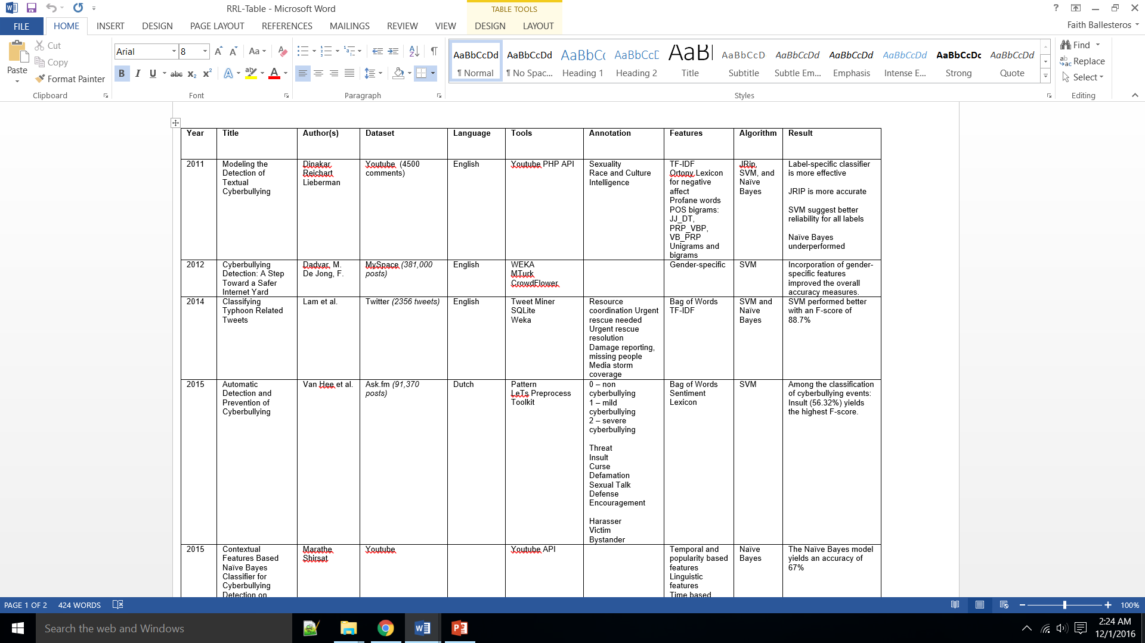
Review of Related Literature

Slide 19
Review of Related Literature
Text Classification by Augmenting Bag of Words (BOW) Representation with Co-occurrence Feature by Soumya and Shibily
To emphasize the importance of using a BoW model in text classification.
Data source: 20 newsgroup data
Preprocessing: Stemming involves
Data Classification: ”alt.atheism”, ”comp.graphics”, ”rec.sport.hockey”, ”sci.electronics”.
They used Naive Bayes classifier as their classification tool.
The classification model yields 90% accuracy.

Slide 20

Review of Related Literature

Slide 21
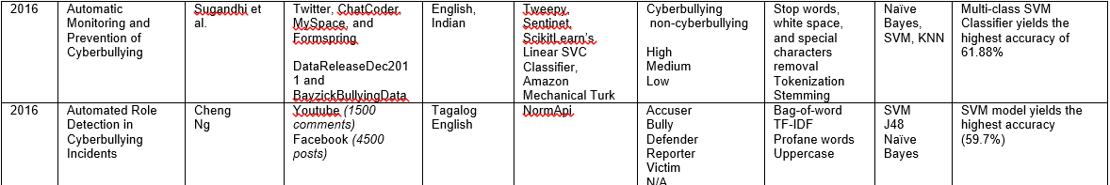
Review of Related Literature

Slide 22
Theoretical Background
People play different roles depending on their audience
Social media allows user to share information about themselves
Limitless audience
User privacy is threatened
Bullies can easily hide their identities
Roles: Performer, Audience, and Outsider = Victim, Bully, and Bystander

Slide 23
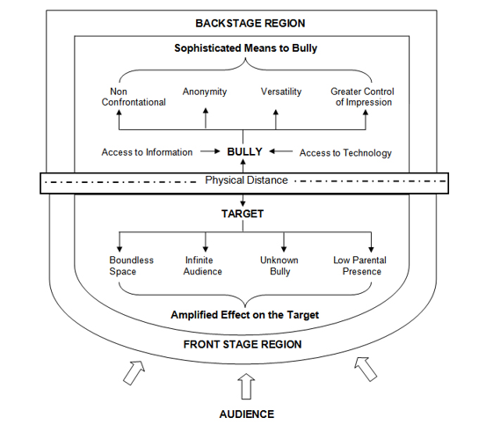
Audience Segregation by
Ervin Goffman

Slide 24
Natural Language Processing
It is a field of study which focuses on discovering ways on how to bridge the gap between interactions involving humans and computers.

Slide 25
Natural Language Processing
A great number of current software applications have been incorporated with NLP tasks in order for them to function appropriately. Some of those tasks are as follows:
Deep Analytics
Machine Translation
Named Entity Extraction
Co-reference Resolution
Automatic Summarization
Sentiment Analysis
Text Classification
Conversational Agents

Slide 26
Text Classification
It is the classification of documents into a fixed number of predefined categories.
Can be single label or multi-label
Begins with the creation of a corpus

Slide 27
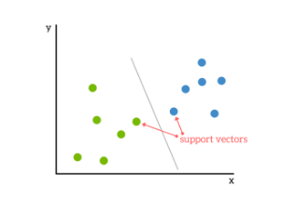
Support Vector Machine
SVMs seeks to find a hyperplane that best divides a dataset into two classes.

Slide 28
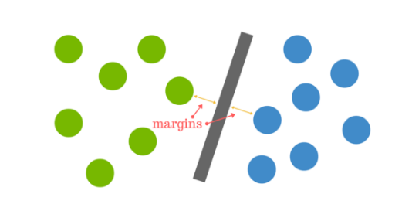

Slide 29
Why SVM?
It yields a high accuracy
It works well with a smaller clean dataset

Slide 30
Bag of Words
The goal of BoW model is to create a numeric representation for the data. In this model, a text is represented as an unordered collection of its words, regardless of its grammar and even word order.
A BoW model is composed of words together with their respective weights.

Slide 31
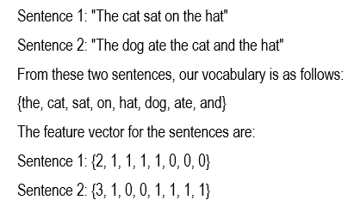
Bag of Words

Slide 32
Performance Measures
Precision is a metric that is computed as the fraction of the correct instances from those that the algorithm labeled as being in the relevant subset.
Recall is computed as the fraction of correct items among those that actually belong to the relevant subset.
F-score is the average of both the precision and recall.

Slide 33
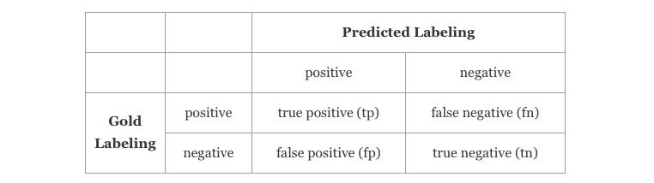
Performance Measures

Slide 34
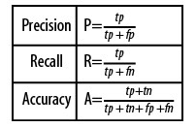
Performance Measures

Slide 35
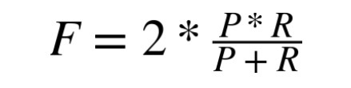
Performance Measures

Slide 36
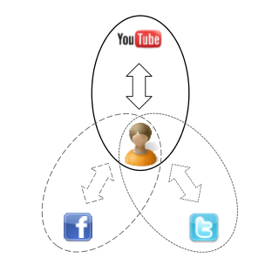
Methodology: Data Collection
Facebook, Twitter and YouTube

Slide 37

Methodology: Data Collection (con.)
The Researchers used Import.Io

Slide 38
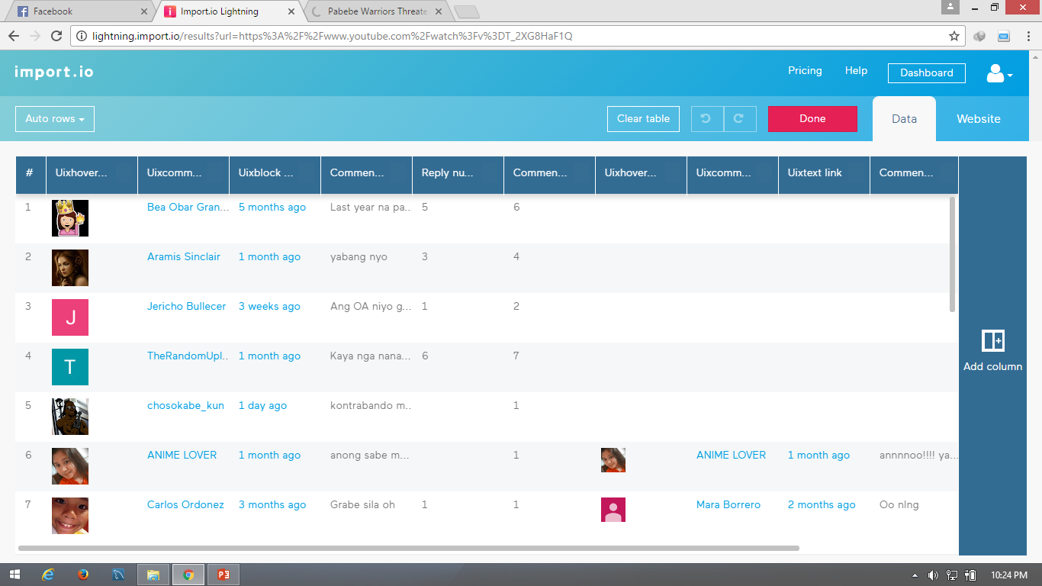

Slide 39
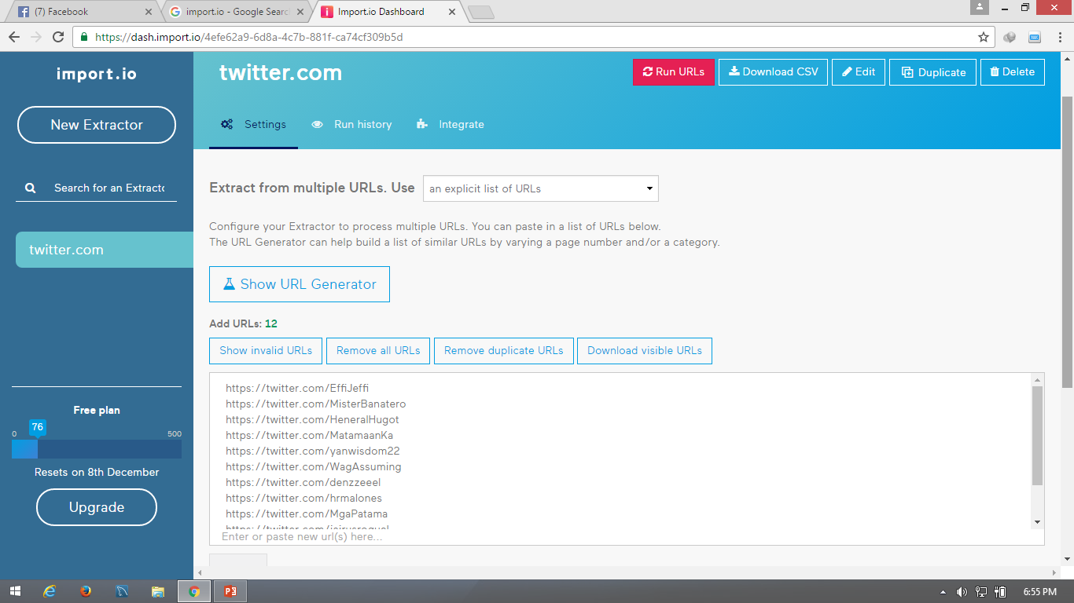
Methodology: Data Collection (con.)
2000 Data
625 Data

Slide 40
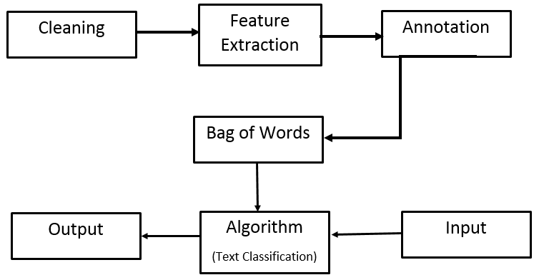
Process Diagram

Slide 41

Methodology: Cleaning of Data
(,|.|?|_|;|:|"|...|https(Links in Facebook, twitter, YouTube inserted)|+|=|{|}|[|]|/|\|<|>|!|@|#|$|%|^|&|*|(|)|||?|ðŸ’ª|O_O|âœŒâœŒâœŒ|(Links of pictures)|nâ€“|nâ’|unreadable words (ex.hsxkssfjhj, asdfgh)|~|’|“|)

Slide 42
Methodology: Feature Extraction
N-Gram
Unigram
Bigram
Trigram
Calculation
Frequency
Tf-idf

Slide 43
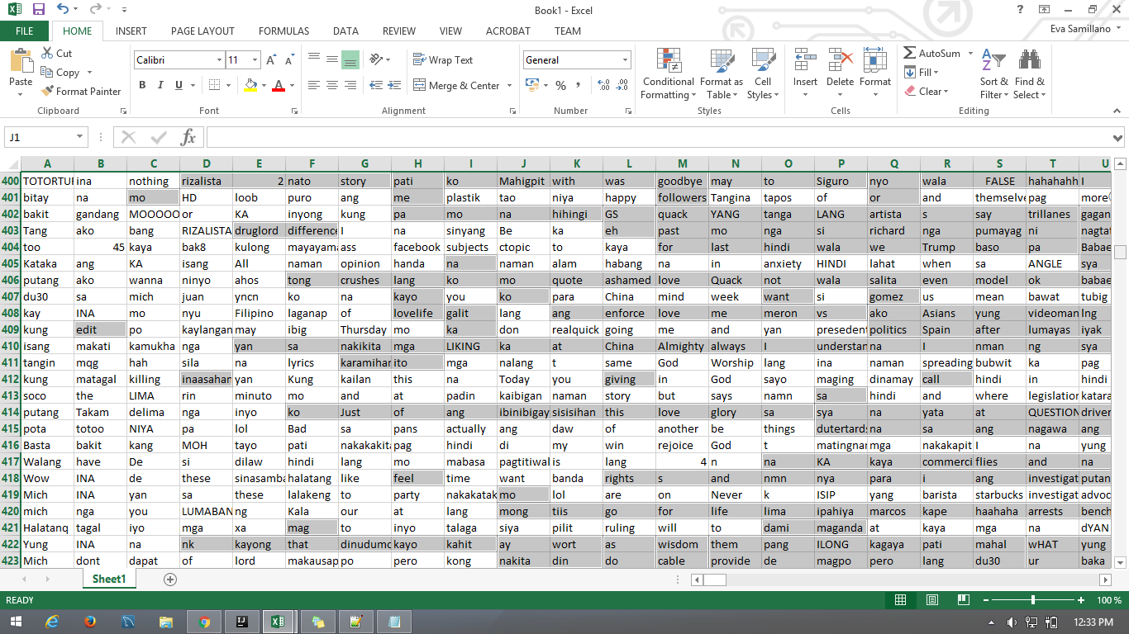
Methodology: Feature Extraction(con.)
The Researchers used Bag of Words (BoW)-Unigram

Slide 44
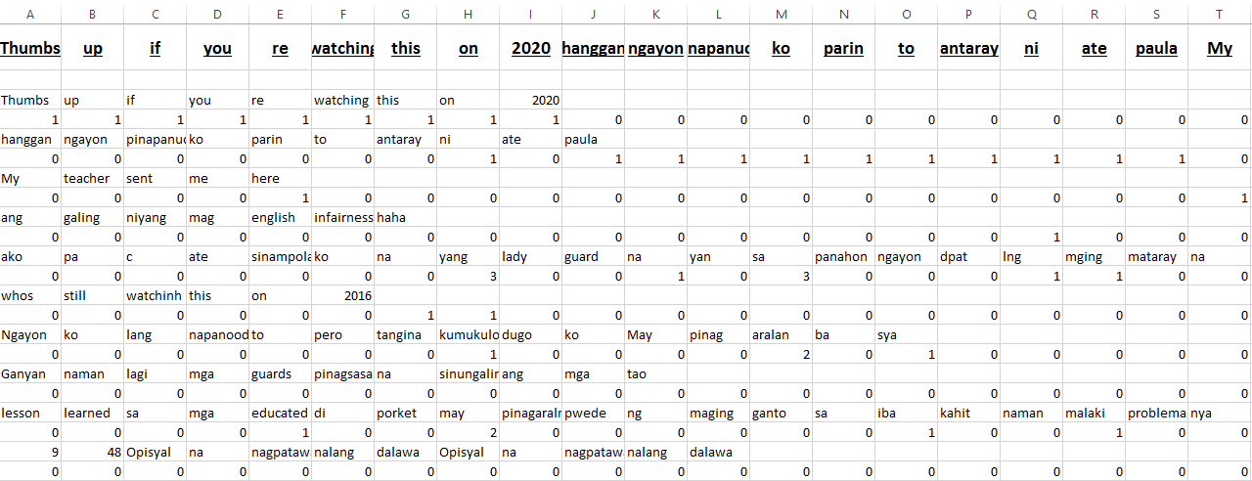
Methodology: Feature Extraction(con.)
Frequency of Bag of Word-Unigram

Slide 45
Methodology: Data Annotation
Conducted a questionnaire for 100 respondents. (10 questions for each respondent)
The project team members were also required to annotate the dataset as well.
Establishment of classes: cyberbullying, non-cyberbullying and ambiguous cyberbullying.

Slide 46

Methodology: Bag of Words

Slide 47
Bag of Words into .arff (Attribute related file format) File
Header – composed of relation name and list of attributes
Data – composed of actual instances data of the corpus
@relation @attribute @data
Title
numeric
<nominal-specification>
string
date [<date-format>]
The frequency or tf-idf

Slide 48
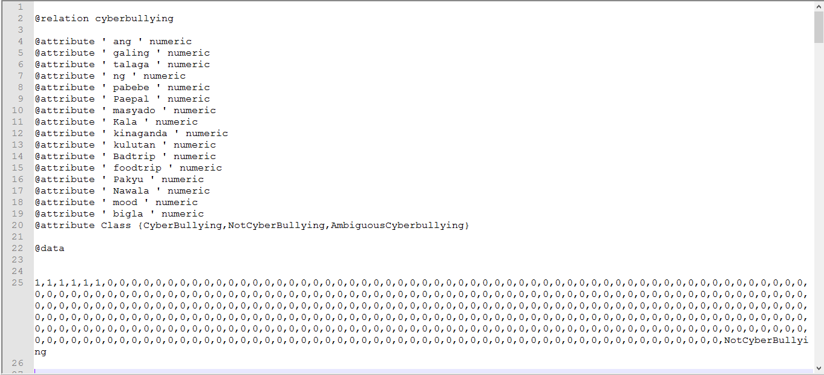

Slide 49

Methodology: Weka
C4.5 data file
XRF (X-ray Fluorescence)file
CSV data file
Libsvm data file
Matlab ASCII file
Binary serialized Instances
SVMlight data file

Slide 50
Methodology: Analysis and Classification
The team used a supervised learning approach to train the classifier in creating a cyberbullying detection model.
They employed a Support Vector Machine (SVM) model in WEKA as a classification tool.

Slide 51
The Researchers splice the data hundreds by hundreds inputting it to Weka
200
500
700 and
900

Slide 52
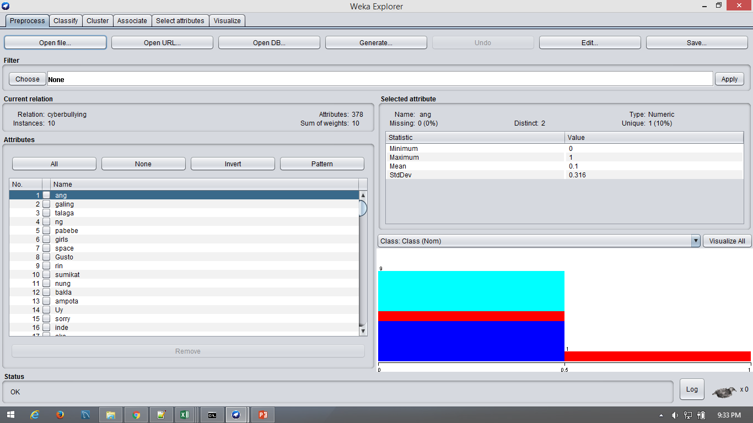
Opening the file into WEKA

Slide 53
Shows the frequency of the specific attribute in graph

Slide 54
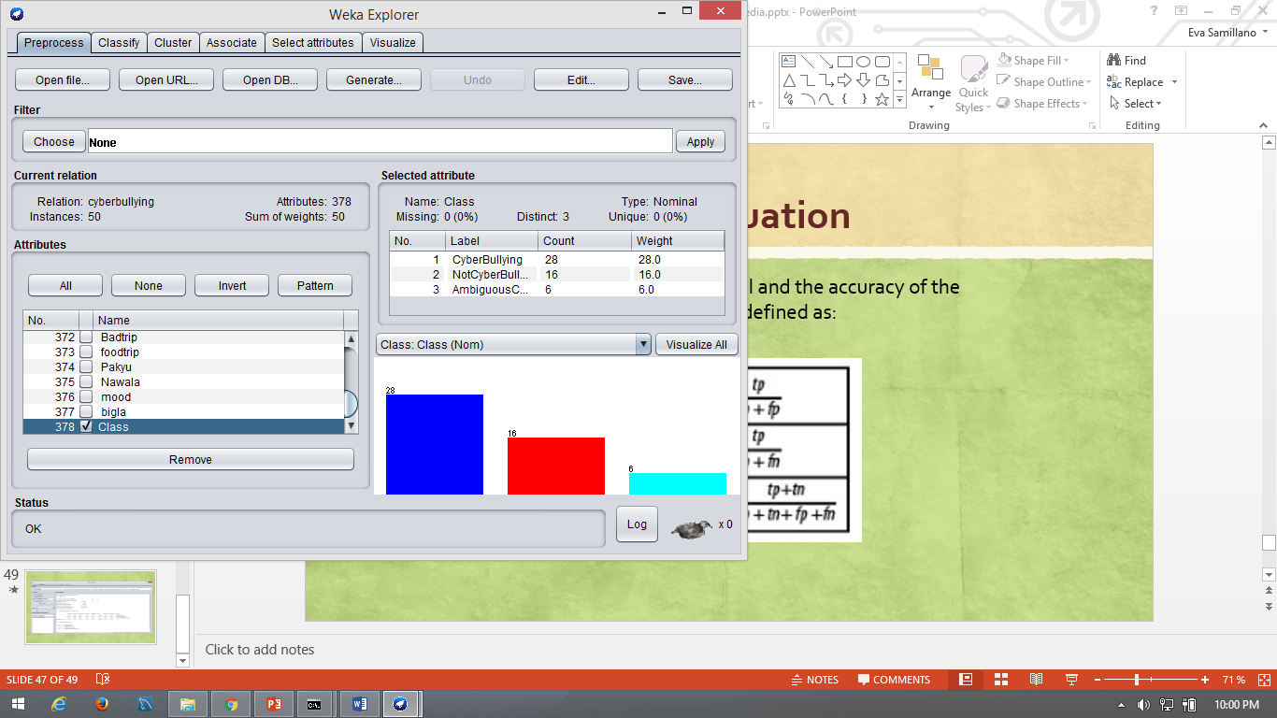
Shows the number of data that Cyberbullying, Not Cyberbullying and Ambiguous Cyberbullying occurred

Slide 55
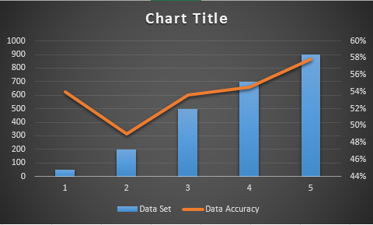
Result and Discussion

Slide 57
Plans for the succeeding term
To create a simple prototype by integrating WEKA toolkit with Java
To Extend the number of statements fed unto WEKA from 900 to 2000
To Use TF-IDF scores to weigh both features and attributes
To Test the model against other machine learning algorithms (Naive Bayes, Decision Trees, Convolutional Neural Network)
To Utilize other forms of the Bag-of-Words method (bigrams, trigrams)
To Create sub-categories for cyberbullying instances
And to Implement the normalization process

